Slide 1
POISED: Spotting Twitter Spam Off the Beaten Paths
Shirin Nilizadeh,¹ Francois Labreche,² Alireza Sedighian,² Ali Zand,¹ Jose Fernandez,² Christopher Kruegel,¹ Gianluca Stringhini,³ and Giovanni Vigna¹
¹UC Santa Barbara, ²Ecole Polytechnique de Montréal, and ³University College London
CCS 2017

Slide 2

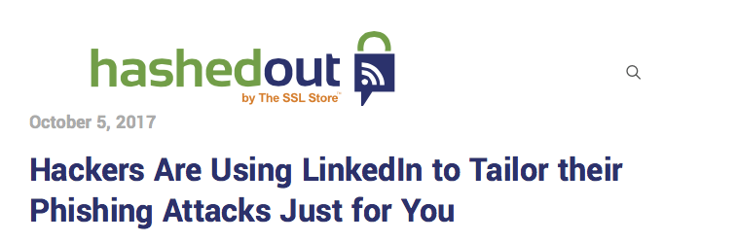
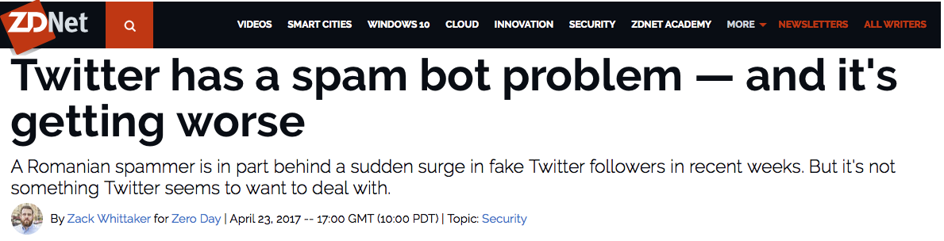

Online social networks are a propitious medium to spread spam and malicious content

Slide 3
Social networks are leveraged by cybercriminals for a number of reasons
Social networks provide a large victim base
Cybercriminals benefit from the inherent trust between connected users

Slide 4
Related work
Detecting malicious messages
Detecting malicious URLs
Detecting malicious accounts
Compromised accounts
Sybil communities

Slide 5
POISED spots spam messages by their diffusion patterns throughout the network

Slide 6
Attack model: no constraint on the type of spam messages, and the accounts posting them
Spam messages are
Posted in a large scale,
Similar in content and format
Sent by:
Fake (Sybil) accounts
Compromised accounts
Social bots

Slide 7
Attack model: spam detection is an adversarial problem
Adversary knows how the detection works and actively attempts to evade it.
But, adversary is only able to compromise some partitions and not the whole social network.

Slide 8
Homophily Principle: Individuals tend to associate and bond with similar others

Slide 9
Hypothesis 1: Topics of interest of users within a networked community are shared among its members

Slide 10
Even some “not neighbor” communities can be interested in the same topics
T_{n}
T₂
T₁
We call these sets of communities interested in the same set of topic parties of Interest.

Slide 11
Based on these observations we can compute the probability distribution for a message being posted in a community
T_{k}
T_{n}
T₂
T₁

Slide 12
Hypothesis 2: The propagation probability of malicious and benign messages are different
T_{i}

Slide 13
POISED constructs a probabilistic model based on the diffusion of messages throughout parties of interest

Slide 14
Data Collection
Crawled timelines for 300 random users, called “seeds,” and their friends and followers.
Also crawled friends and followers lists of them
We call each seed and its friends and followers a neighborhood.
The dataset includes about 82K users and 15M tweets.

Slide 15
Network Construction and Community Detection
For each neighborhood, two networks, directed and undirected, are constructed using following relationships.
Infomap algorithm detected a total of 2,283 communities.

Slide 16
Topic Detection: Latent Dirichlet Allocation (LDA) is used to detect topics of interest of communities
Timeline for User 1
Timeline for User n
Document 1
Document 1
Soccer
Fitness
IT
IT
Document 2
Document 2
IT
Topics for Comm. 1
IT
Weather
Fitness
IT
IT
Document k
Document h

Slide 17
Examine H1 by computing entropy-based metrics
Completeness: if all documents of a community are about the same topic
Homogeneity: if a topic is only talked about in a single community
Interpretation:
Higher completeness: members of a community are interested in the same topics.
Higher homogeneity: communities have distinguishable topics of interest.

Slide 18
Validate H1 by comparing metrics with those of Null model
Null model is a random partitioning of documents into clusters.
Network 1
Comm. 1
IT: 200
Weather: 50
Random Network
Comm. 1
IT: 90
Weather: 35
Fitness: 100
Art: 15
Comm. 2
Fitness: 200
Art: 30
Weather: 20
Comm. 2
Weather: 35
IT: 110
Art: 15
Fitness: 100

Slide 19
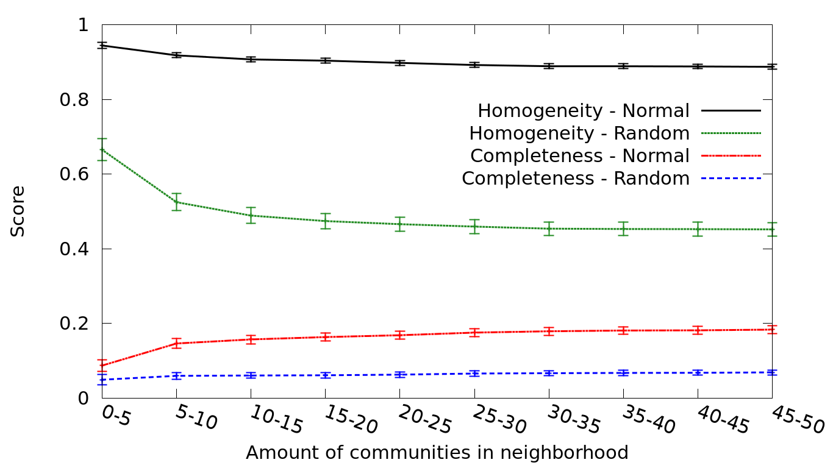
First hypothesis is satisfied: Topics of interest of users within a networked community are shared among its members
Homogeneity
Completeness

Slide 20
POISED constructs a probabilistic model based on diffusion of messages throughout parties of interest

Slide 21
Employed four-gram analysis to Identify groups of similar messages
Four-gram analysis: messages that share four or more consecutive words are clustered together.

Slide 22
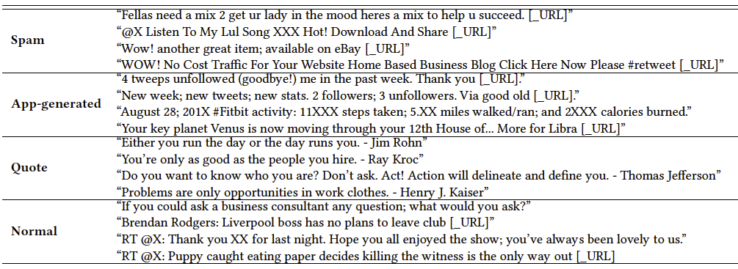
Manually labeled the top 5000 groups
A group of 14 security researchers
Categories are: spam, app, quote and normal.

Slide 23
The probabilistic table represents parties of interest
Comm. 1
Topic₁
Topic₂
Comm. 3
Topic₁
Topic₄
Topic₅
20 msgs
g₁
10 msgs
Comm. 2
Topic₁
Topic₃
Groups | Topic₁ | Topic₂ | Topic₃ | Topic₄ | Topic₅ | … | Topic_{k}

Slide 24
The probabilistic table represents parties of interest
Comm. 1
Topic₁
Topic₂
Comm. 3
Topic₁
Topic₄
Topic₅
20 msgs
g₁
10 msgs
Comm. 2
Topic₁
Topic₃
Groups | Topic₁ | Topic₂ | Topic₃ | Topic₄ | Topic₅ | … | Topic_{k}
g₁ | 30 | 20 | 10 | 0 | 0 | … | 0

Slide 25
The probabilistic table represents parties of interest
5 msgs
Comm. 1
Topic₁
Topic₂
Comm. 3
Topic₁
Topic₄
Topic₅
10 msgs
g₁
g₂
Comm. 2
Topic₁
Topic₃
Groups | Topic₁ | Topic₂ | Topic₃ | Topic₄ | Topic₅ | … | Topic_{k}
g₁ | 30/60 | 20/60 | 10/60 | 0 | 0 | … | 0

Slide 26
The probabilistic table represents parties of interest
5 msgs
Comm. 1
Topic₁
Topic₂
Comm. 3
Topic₁
Topic₄
Topic₅
10 msgs
g₁
g₂
Comm. 2
Topic₁
Topic₃
Groups | Topic₁ | Topic₂ | Topic₃ | Topic₄ | Topic₅ | … | Topic_{k}
g₁ | 30/60 | 20/60 | 10/60 | 0 | 0 | … | 0
g₂ | 15/25 | 0 | 0 | 5/25 | 5/25 | … | 0
…

Slide 27
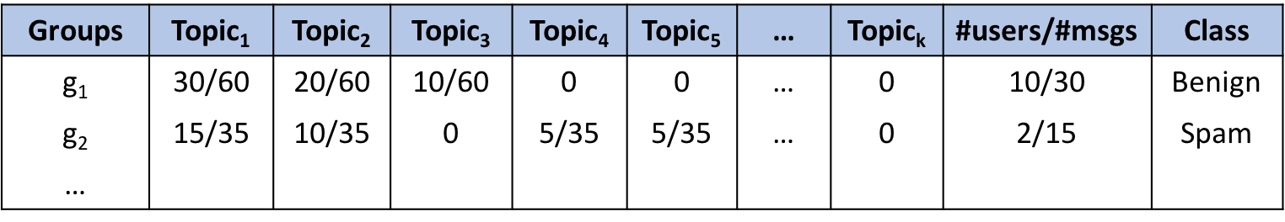
Supervised machine learning
Comb. 1: Spam = {spam}; Benign = {normal, quote, app}
Comb. 2: Spam = {spam}; Benign = {normal }
Comb. 3: Spam = {spam, app}; Benign = {normal, quote}

Slide 28
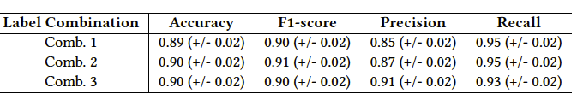
With high precision (91%) and recall (93%) POISED’s classifier successfully detects spam messages
Unbalanced dataset: SMOTE
Tested multiple classification algorithms
To evaluate our classifier, we ran k-cross validation

Slide 29
POISED detects spam accounts by examining the distribution of their messages
Benign
Spam

Slide 30
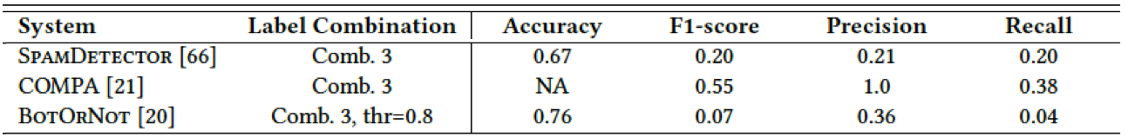
POISED outperforms three state-of-the-art systems
SpamDetector: fake accounts; examining user profile characteristics
COMPA: compromised accounts; flagging abnormal user behaviors
BotOrNot: social bots; using more than a thousand features
These systems can only detect certain types of spam while POISED aims to detect any malicious message.

Slide 31
Early Detection: POISED is effective detecting spam messages early on
Simulation
The propagation probabilities are only computed for some % of communities
Assumes that the spam message has not been reached the remaining communities.
When spam messages have only propagated through 30% of the communities, POISED effectively detects them with 90% precision and 75% recall.

Slide 32
Adversarial machine learning attacks: we investigate the robustness of POISED against adversarial settings
Assumptions:
Some communities are compromised
The adversary observes the diffusion patterns of benign messages in the compromised communities
Attack:
Make the propagation of her spam messages be as similar as possible to that of benign messages

Slide 33
Adversarial machine learning attacks
Compromised
Comm. 1
Topic₁
Topic₂
Comm. 3
Topic₁
Topic₄
Topic₅
10 spam msgs
20 msgs
g₁
g₃
10 msgs
Compromised
Comm. 2
Topic₁
Topic₃
10 spam msgs
Groups | Topic ₁ | Topic₂ | Topic₃ | Topic₄ | Topic₅ | … | Topic_{k}
g₁ | 40 | 10 | 20 | 10 | 10 | … | 0
g₂ | 15 | 0 | 0 | 5 | 5 | … | 0
…

Slide 34
Adversarial machine learning attacks
Compromised
Comm. 1
Topic₁
Topic₂
Comm. 3
Topic₁
Topic₄
Topic₅
10 spam msgs
20 msgs
g₁
g₃
10 msgs
Compromised
Comm. 2
Topic₁
Topic₃
10 spam msgs
Groups | Topic ₁ | Topic₂ | Topic₃ | Topic₄ | Topic₅ | … | Topic_{k}
g₁ | 40 | 20 | 10 | 10 | 10 | … | 0
g₂ | 15 | 0 | 0 | 5 | 5 | … | 0
g₃ | 10 | 0 | 10 | 10 | 10 | … | 0

Slide 35
Poisoning Attack: At the training phase, the adversary attempts to mislead the classifier by “poisoning” training data
Simulation:
Randomly picked some communities to be compromised
Modify the diffusion pattern of every spam message in the compromised communities to match that of a random benign message
Do not change the diffusion pattern of spam messages in other communities
Use this poisoned data to train the classifier

Slide 36
Evasion Attack: At the testing phase, the adversary carefully manipulates attack samples to evade detection
Simulation:
Randomly picked some communities to be compromised
Change the diffusion pattern of every spam message in the compromised communities to match that of a random benign message
Do not change the diffusion pattern of spam messages in other communities
The original “un-poisoned” data is used to train the classifier while the testing set includes the manipulated samples

Slide 37
The attacker needs to have a great knowledge about the network to highly impact the performance
If 30% of the network is compromised, the precision and recall remain at 82% and 87% in the case of a poisoning attack, and at 75% and 52% in the case of an evasion attack.

Slide 38
Summary
POISED is the first system that detects spam messages by predicting the diffusion patterns of messages in the social network.
POISED outperforms other state-of-the-art detection systems.
Our simulation results show that spam messages can be detected early on
POISED is difficult to evade for an active adversary.

Slide 39
Thanks, questions?
Contact: nilizadeh@ucsb.edu

Slide 41
Complexity and Scalability: POISED is practical even at the scale of Twitter
Community detection: linear with respect to number of nodes
Topic Detection (LDA): O(NKV ), where N, K, and V are number of documents, topics and words in the vocabulary. This can be improved with the use of heuristics:
Decreasing the number of documents
specifying a lower number of topics.
Groups of similar messages: can be optimized to close to linear
Ground-truth dataset: requires minimal effort since it can use user reports
To increase the efficiency, POISED can be run on parallel on partitions of network.

Slide 42
Spam: unsolicited, repeated actions that negatively impact other users
Posting harmful links
Creating multiple accounts
Posting repeatedly to trending topics
Repeatedly posting duplicate updates
Posting links with unrelated Tweets
Src: https://support.twitter.com/articles/64986

Slide 43
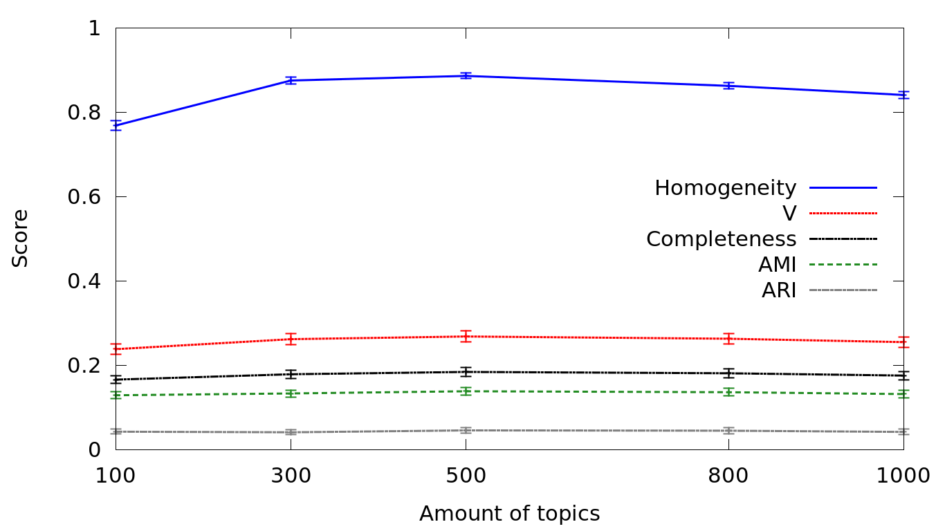
Number of topics does not have a huge impact on the scores

Slide 44
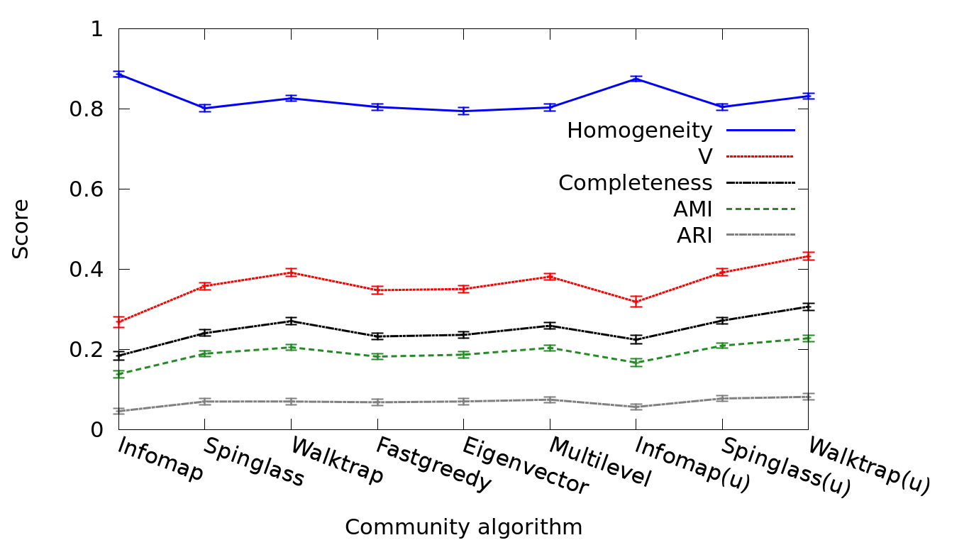
The choice of community detection algorithm does not have a huge impact on the scores

Slide 45
Data is collected through Twitter API
Crawled timelines for 300 random users, called “seeds,” and their friends and followers.
Also crawled friends and followers lists of them
We call each seed and its friends and followers a neighborhood.
Timeline Length

Slide 46
Following relationships are used to construct networks
For each neighborhood, two networks, directed and undirected, are constructed.
Applied k-core to extract the maximal connected subgraphs, here k=2.
The dataset includes about 82K users and 15M tweets.
Neighborhood size

Slide 47
Employed Infomap community detection algorithm and detected about 2,300 communities
While on average neighborhoods contain 8 communities, a handful of them contain more than 30 communities.
Number of communities
Size of communities

Slide 48
Labeling 5000 groups of similar messages, we obtained labels for about 1.3M tweets

